Slide 1
Sunscreen: More Damaging Than Good?
By: Erin Cox

Slide 2
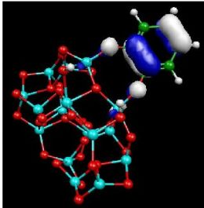
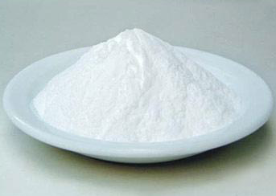
Ingredients
Titanium Dioxide
Zinc Oxide

Slide 3
Nanoparticles
< 100nm in size
Made this small in order to appear clear on the skin
Does making them that small allow the particles to be absorbed into our system?

Slide 4
Are they safe?
Damaging to tissues
Lung tissue after exposed to UV light
After 3 hours 50% lung cells died
After 12 hours 90% lung cells died
Genotoxic
Decrease mitochondrial activity
Change cellular morphology
Disturb cell cycle distribution

Slide 5
How?
When exposed to light, TiO2 and ZO release electrons, producing free radicles, which then damage the tissues they come in contact with

Slide 6
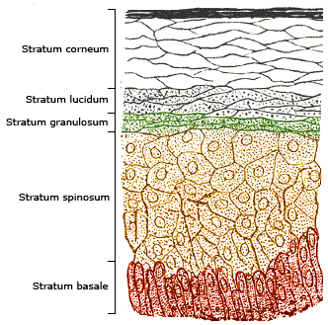
Do we absorb the nanoparticles?
If skin is intact, no. Nanoparticles will not pass the stratum corneum

Slide 7
What if skin is broken?
Nanoparticles will be allowed to travel deeper in the skin and affect live tissue
Theory of sunscreen actually causing more Melenoma? This is why
Not only cuts or abrasions, but what if you put sunscreen on already burnt skin!

Slide 8
Different Alternatives
Nanoparticle free sunscreens:
Alba Botanica
Avalon Organics
Blistex
Bullfrog
Tattoo Goo
Soleo Organics
Or COCONUT OIL! ☺

Slide 9
References Papers
Hackenberg S, Kleinsasser N. Dermal toxicity of ZnO nanoparticles: a worrying feature of sunscreen? Nanomedicine (Lond). 2012 Apr;7(4):461-3. PubMed PMID:22471715.
Kocbek P, Teskac K, Kreft ME, Kristl J. Toxicological aspects of long-term treatment of keratinocytes with ZnO and TiO2 nanoparticles. Small. 2010 Sep 6;6(17):1908-17. PubMed PMID: 20677183.
Ng KW, Khoo SP, Heng BC, Setyawati MI, Tan EC, Zhao X, Xiong S, Fang W, Leong DT, Loo JS. The role of the tumor suppressor p53 pathway in the cellular DNA damage response to zinc oxide nanoparticles. Biomaterials. 2011 Nov;32(32):8218-25. Epub 2011 Jul 31. PubMed PMID: 21807406.
Lai JC, Lai MB, Jandhyam S, Dukhande VV, Bhushan A, Daniels CK, Leung SW. Exposure to titanium dioxide and other metallic oxide nanoparticles induces cytotoxicity on human neural cells and fibroblasts. Int J Nanomedicine. 2008;3(4):533-45. PubMed PMID: 19337421; PubMed Central PMCID: PMC2636591.
Cross SE, Innes B, Roberts MS, Tsuzuki T, Robertson TA, McCormick P. Human skin penetration of sunscreen nanoparticles: in-vitro assessment of a novel micronized zinc oxide formulation. Skin Pharmacol Physiol. 2007;20(3):148-54. Epub 2007 Jan 17. PubMed PMID: 17230054.
Zvyagin AV, Zhao X, Gierden A, Sanchez W, Ross JA, Roberts MS. Imaging of zinc oxide nanoparticle penetration in human skin in vitro and in vivo. J Biomed Opt. 2008 Nov-Dec;13(6):064031. PubMed PMID: 19123677.
Kimura, Eriko, Kawano, Yuichiro, et al. Measurement of Skin Permeation/Penetration of Nanoparticles for Their Safety Evaluation. Biol. Pharm. Bull. 35(9)pg 1476-1486.

Slide 10
References Websites
http://www.organicconsumers.org/articles/article_18007.cfm
http://www.cancer.org.au/preventing-cancer/sun-protection/nanoparticles-and-sunscreen.html
http://breakingnews.ewg.org/2012sunscreen/sunscreens-exposed/sunscreens-exposed-9-surprising-truths/

